Slide 1
CSE477
VLSI Digital Circuits
Fall 2002
Lecture 10: The Inverter, A Dynamic View
Mary Jane Irwin ( www.cse.psu.edu/~mji ) www.cse.psu.edu/~cg477
[Adapted from Rabaey’s Digital Integrated Circuits, ©2002, J. Rabaey et al.]

Slide 2
Inverter Propagation Delay
Propagation delay is proportional to the time-constant of the network formed by the pull-down resistor and the load capacitance
t_{pHL} = ln(2) R_{eqn} C_{L} = 0.69 R_{eqn} C_{L}
t_{pLH} = ln(2) R_{eqp} C_{L} = 0.69 R_{eqp} C_{L}
t_{p} = (t_{pHL} + t_{pLH})/2 = 0.69 C_{L}(R_{eqn} + R_{eqp})/2
To equalize rise and fall times make the on-resistance of the NMOS and PMOS approximately equal.
V_{DD}
t_{pHL} = f(R_{n}, C_{L})
V_{out} = 0
R_{n}
C_{L}
V_{in} = V _{DD}
Notes:
Often desirable to have identical propagation delays for both rising and falling inputs. This condition can be achieved by making the on-resistance of the NMOS and PMOS approximately equal. This is the SAME condition as that for a symmetrical VTC.

Slide 3
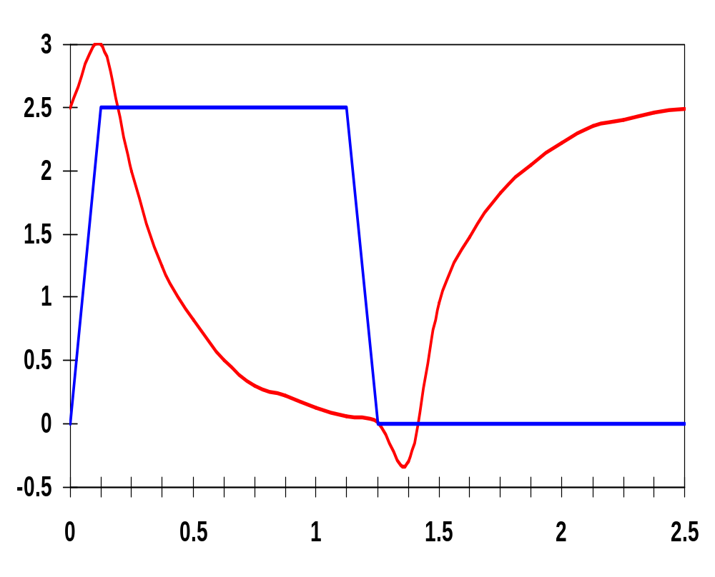
Inverter Transient Response
V_{DD}=2.5V
0.25μm
W/L_{n} = 1.5
W/L_{p} = 4.5
R_{eqn}= 13 kΩ (÷ 1.5)
R_{eqp}= 31 kΩ (÷ 4.5)
V_{in}
V_{out} (V)
x 10⁻¹⁰
t (sec)
Notes:
For class handout

Slide 4
Inverter Transient Response
V_{DD}=2.5V
0.25μm
W/L_{n} = 1.5
W/L_{p} = 4.5
R_{eqn}= 13 kΩ (÷ 1.5)
R_{eqp}= 31 kΩ (÷ 4.5)
V_{in}
V_{out} (V)
t_{f}
t_{r}
t_{pHL}
t_{pLH}
t_{pHL} = 36 psec
t_{pLH} = 29 psec
so
t_{p} = 32.5 psec
x 10⁻¹⁰
t (sec)
From simulation: t_{pHL} = 39.9 psec and t_{pLH} = 31.7 psec
Notes:
For lecture
Reqn = 8.67 and Reqp = 6.89
The top time is from simulation
the bottom from solving the (simplified) equations
Note overshoots on simulated output signals. Caused by the gate-drain capacitances of the inverter transistors which couple the steep voltage step at the input node directly to the output before the transistors can even start to react to the changes at the inputs.
These overshoots have a negative effect on gate performance and explain why the simulated delays are larger than the estimations.

Slide 5
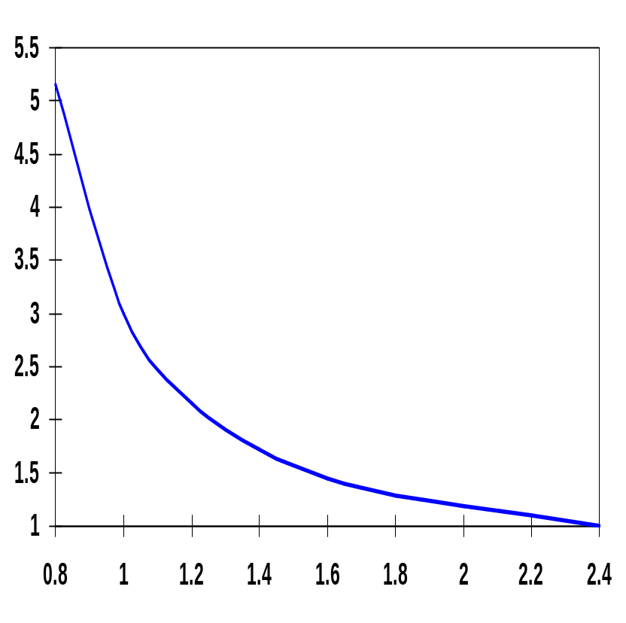
Inverter Propagation Delay, Revisited
To see how a designer can optimize the delay of a gate have to expand the R_{eq} in the delay equation
t_{p(normalized)}
t_{pHL} = 0.69 R_{eqn} C_{L}
  = 0.69 (3/4 (C_{L} V_{DD})/I_{DSATn} )
  ≈ 0.52 C_{L} / (W/L_{n} k’_{n} V_{DSATn} )
V_{DD} (V)
Notes:
If the supply voltage is high enough so that VDD >> VTn + VDSATn/2, the delay becomes virtually independent of the supply voltage!
Similar equation for tpLH based on W/Lp
Propagation delay of a CMOS inverter as a function of supply voltage (normalized wrt delay at 2.5V supply).
While the delay is relatively insensitive to supply variations for higher values of VDD, a sharp increase can be observed starting around 2VT.
This operation regions should be avoided for high performance!
Lowering VDD slows down the gate

Slide 6
Design for Performance
Reduce C_{L}
  internal diffusion capacitance of the gate itself
    keep the drain diffusion as small as possible
  interconnect capacitance
  fanout
Increase W/L ratio of the transistor
  the most powerful and effective performance optimization tool in the hands of the designer
  watch out for self-loading! – when the intrinsic capacitance dominates the extrinsic load
Increase V_{DD}
  can trade-off energy for performance
  increasing V_{DD} above a certain level yields only very minimal improvements
  reliability concerns enforce a firm upper bound on V_{DD}
Notes:
Good design practice keeps drain diffusion areas as small as possible
Self-loading is when the intrinsic capacitance (diffusion capacitance) starts to dominate the extrinsic load formed by wiring and fanout.
Increasing VDD also has reliability concerns - oxide breakdown, hot-electron effects - that enforce firm upper bounds on the supply voltage in deep submicron processes.

Slide 7
NMOS/PMOS Ratio
So far have sized the PMOS and NMOS so that the R_{eq}’s match (ratio of 3 to 3.5)
  symmetrical VTC
  equal high-to-low and low-to-high propagation delays
If speed is the only concern, reduce the width of the PMOS device!
  widening the PMOS degrades the t_{pHL} due to larger parasitic capacitance
β = (W/L_{p})/(W/L_{n})
r = R_{eqp}/R_{eqn} (resistance ratio of identically-sized PMOS and NMOS)
β_{opt} = √r when wiring capacitance is negligible
Notes:
Smaller PMOS - speed at the cost of symmetry and noise margin
Widening PMOS of course improves tpLH because it improves Req of the PMOS (increases charge current)
If wiring capacitance dominates, larger values of beta should be used. The surprising result is that smaller device sizes (and hence smaller area) yield a faster design at the expense of symmetry and noise margin.

Slide 8
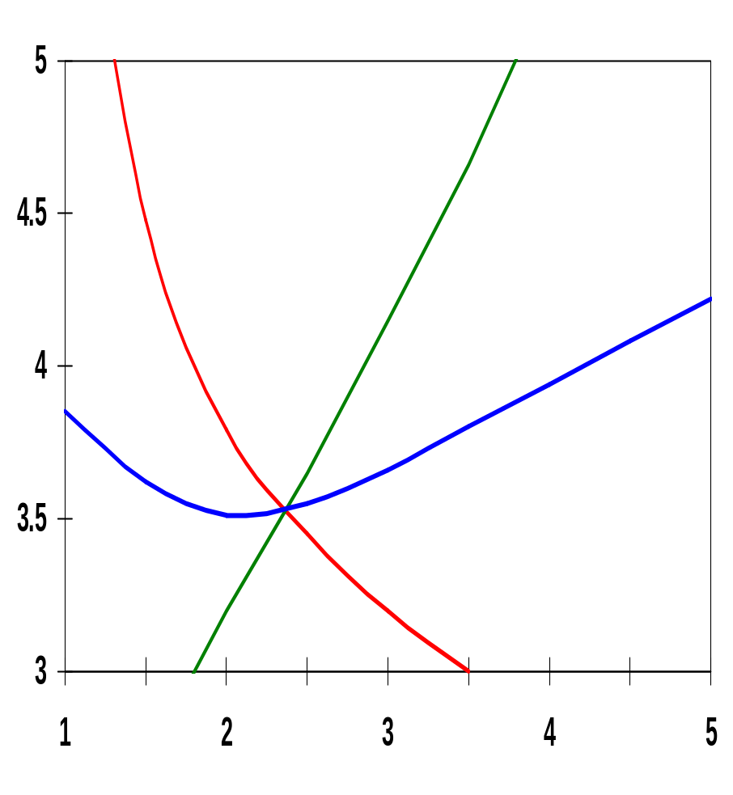
PMOS/NMOS Ratio Effects
x 10⁻¹¹
t_{pLH}
t_{pHL}
β of 2.4 (= 31 kΩ/13 kΩ) gives symmetrical response
β of 1.6 to 1.9 gives optimal performance
t_{p}
t_{p}(sec)
β = (W/L_{p})/(W/L_{n})
Notes:
Observe that the rising and falling delays are identical at the predicted point of beta of 2.4 (the crossing point of the three curves) that is the preferred operation point when the worst-case delay is the prime concern.

Slide 9
Device Sizing for Performance
Divide capacitive load, C_{L}, into
  C_{int} : intrinsic - diffusion and Miller effect
  C_{ext} : extrinsic - wiring and fanout
  t_{p} = 0.69 R_{eq} C_{int} (1 + C_{ext}/C_{int}) = t_{p0} (1 + C_{ext}/C_{int})
  where t_{p0} = 0.69 R_{eq} C_{int} is the intrinsic (unloaded) delay of the gate
Widening both PMOS and NMOS by a factor S reduces R_{eq} by an identical factor (R_{eq} = R_{ref}/S), but raises the intrinsic capacitance by the same factor (C_{int} = SC_{iref})
  t_{p} = 0.69 R_{ref} C_{iref} (1 + C_{ext}/(SC_{iref})) = t_{p0}(1 + C_{ext}/(SC_{iref}))
  t_{p0} is independent of the sizing of the gate; with no load the drive of the gate is totally offset by the increased capacitance
  any S sufficiently larger than (C_{ext}/C_{int}) yields the best performance gains with least area impact
Notes:
Making S infinitely large yields the maximum obtainable performance gain – yet any size factor S that is sufficiently larger than (Cext/Cint) will produce good results at substantial gains in silicon area.
For our example a ratio of 1.05 works (Cint – 3.0 fF and Cext = 3.15 fF) and would predict a maximum performance gain of 2.05
A scaling factor of 10 allows us to get within 10% of this optimal performance (larger devices yield negligible additional performance gains)

Slide 10
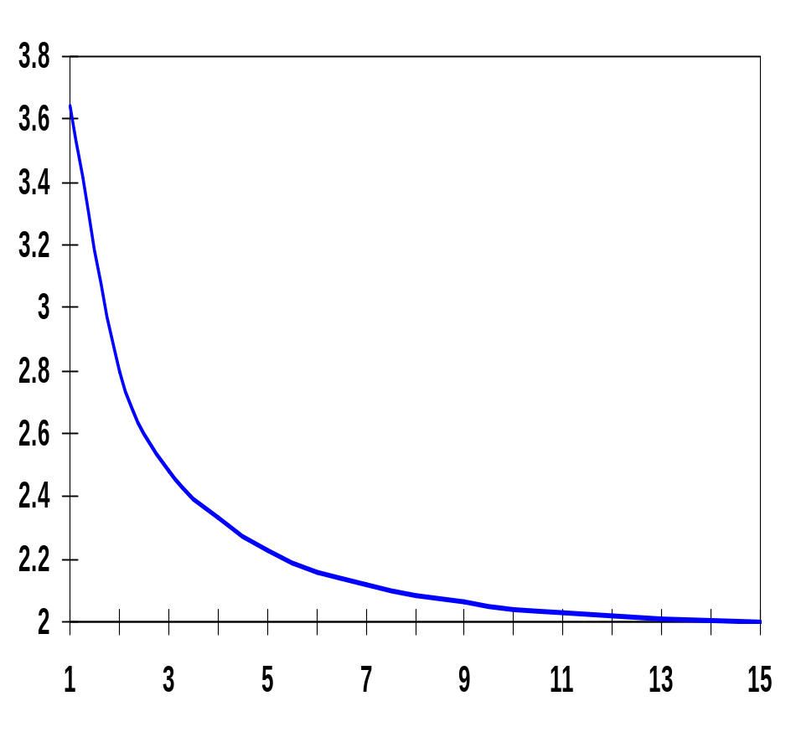
Sizing Impacts on Delay
The majority of the improvement is already obtained for S = 5. Sizing factors larger than 10 barely yield any extra gain (and cost significantly more area).
x 10⁻¹¹
for a fixed load
t_{p}(sec)
S
self-loading effect (intrinsic capacitance dominates)
Notes:
Making S infinitially large yields the maximum obtainable performance gains.
Bulk of the improvement is already obtained for S = 5, sizing factors larger than 10 barely yield any extra gain.
While sizing up an inverter reduces its delay, it also increase its input capacitance – impacting the delay of the driving gate!

Slide 11
Impact of Fanout on Delay
Extrinsic capacitance, C_{ext}, is a function of the fanout of the gate - the larger the fanout, the larger the external load.
First determine the input loading effect of the inverter. Both C_{g} and C_{int} are proportional to the gate sizing, so C_{int} = γC_{g} is independent of gate sizing and
t_{p} = t_{p0} (1 + C_{ext}/ γC_{g}) = t_{p0} (1 + f/γ)
i.e., the delay of an inverter is a function of the ratio between its external load capacitance and its input gate capacitance: the effective fan-out f
f = C_{ext}/C_{g}
Notes:
gamma is close to 1 for most submicron processes.

Slide 12
Inverter Chain
Real goal is to minimize the delay through an inverter chain
the delay of the j-th inverter stage is
t_{p,j} = t_{p0} (1 + C_{g,j+1}/(γC_{g,j})) = t_{p0}(1 + f_{j}/ γ)
and t_{p} = t_{p1} + t_{p2} + . . . + t_{pN}
so t_{p} = ∑t_{p,j} = t_{p0} ∑ (1 + C_{g,j+1}/(γC_{g,j}))
In
Out
1
2
N
C_{g,1}
C_{L}
If C_{L} is given
  How should the inverters be sized?
  How many stages are needed to minimize the delay?
Notes:
ingores wiring capacitance for now

Slide 13
Sizing the Inverters in the Chain
The optimum size of each inverter is the geometric mean of its neighbors – meaning that if each inverter is sized up by the same factor f wrt the preceding gate, it will have the same effective fan-out and the same delay
f = √C_{L}/C_{g,1} = √F
where F represents the overall effective fan-out of the circuit (F = C_{L}/C_{g,1})
and the minimum delay through the inverter chain is
t_{p} = N t_{p0} (1 + ( √F ) / γ)
The relationship between t_{p} and F is linear for one inverter, square root for two, etc.
N
N
N
Notes:
Next question is, “what is the best N to minimize the delay for a given F?”
but first, an example of inverter chain sizing

Slide 14
Example of Inverter Chain Sizing
In
Out
1
C_{g,1}
C_{L} = 8 C_{g,1}
C_{L}/C_{g,1} has to be evenly distributed over N = 3 inverters
C_{L}/C_{g,1} = 8/1
f =
Notes:
for class handout

Slide 15
Example of Inverter Chain Sizing
In
Out
1
f = 2
f² = 4
C_{g,1}
C_{L} = 8 C_{g,1}
C_{L}/C_{g,1} has to be evenly distributed over N = 3 inverters
C_{L}/C_{g,1} = 8/1
f =
3
√8 = 2
Notes:
For lecture

Slide 16
Determining N: Optimal Number of Inverters
What is the optimal value for N given F (=f^{N}) ?
  if the number of stages is too large, the intrinsic delay of the stages becomes dominate
  if the number of stages is too small, the effective fan-out of each stage becomes dominate
The optimum N is found by differentiating the minimum delay expression divided by the number of stages and setting the result to 0, giving
γ + √F - ( √F lnF)/N = 0
For γ = 0 (ignoring self-loading) N = ln (F) and the effective-fan out becomes f = e = 2.71828
For γ = 1 (the typical case) the optimum effective fan-out (tapering factor) turns out to be close to 3.6
N
N

Slide 17
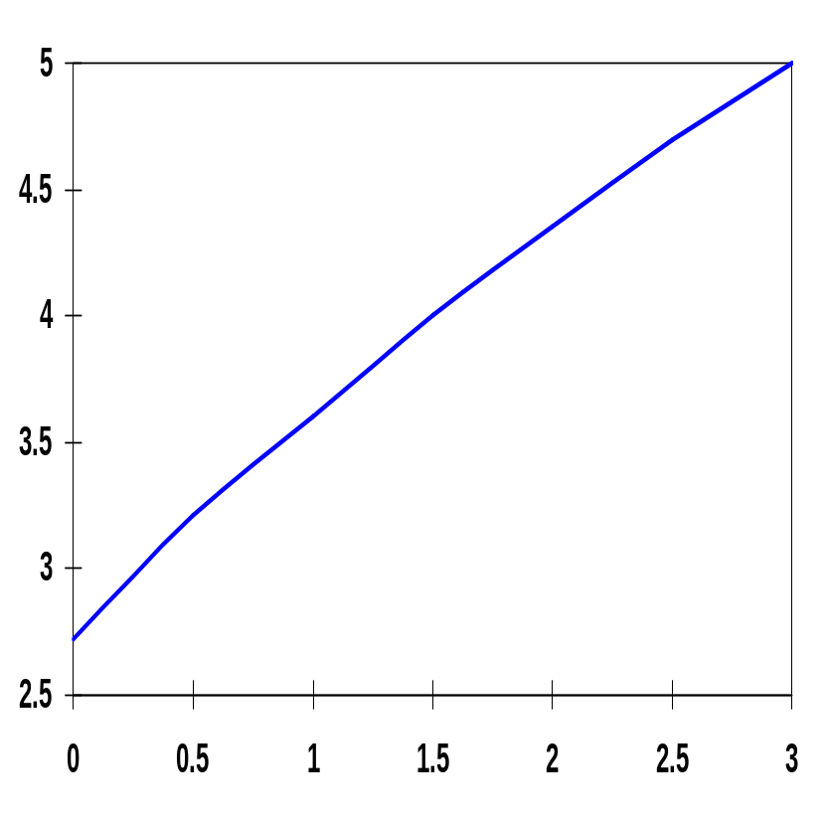
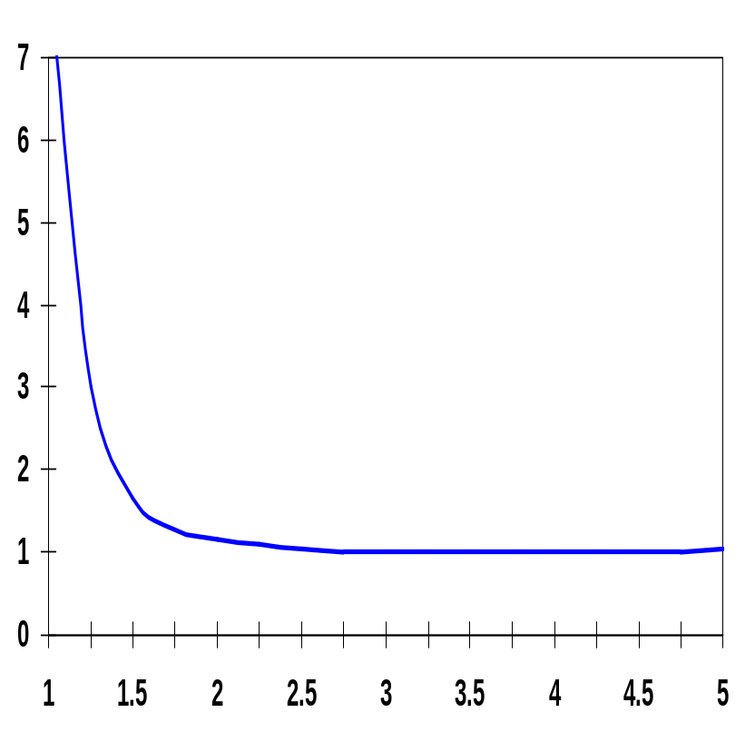
Optimum Effective Fan-Out
normalized delay
F_{opt}
γ
f
Choosing f larger than optimum has little effect on delay and reduces the number of stages (and area).
  Common practice to use f = 4 (for γ = 1)
  But too many stages has a substantial negative impact on delay
Notes:
note that curve on the left starts to increase at 5 ! reinforcing last bullet

Slide 18
Example of Inverter (Buffer) Staging
N f t_{p}
1 64 65
2 8 18
3 4 15
4 2.8 15.3
1
C_{g,1} = 1
C_{L} = 64 C_{g,1}
1
8
C_{g,1} = 1
C_{L} = 64 C_{g,1}
1
4
16
C_{g,1} = 1
C_{L} = 64 C_{g,1}
1
2.8
8
22.6
C_{g,1} = 1
C_{L} = 64 C_{g,1}

Slide 19
Impact of Buffer Staging for Large C_{L}
F (γ = 1) | Unbuffered | Two Stage Chain | Opt. Inverter Chain
10 | 11 | 8.3 | 8.3
100 | 101 | 22 | 16.5
1,000 | 1001 | 65 | 24.8
10,000 | 10,001 | 202 | 33.1
Impressive speed-ups with optimized cascaded inverter chain for very large capacitive loads.

Slide 20
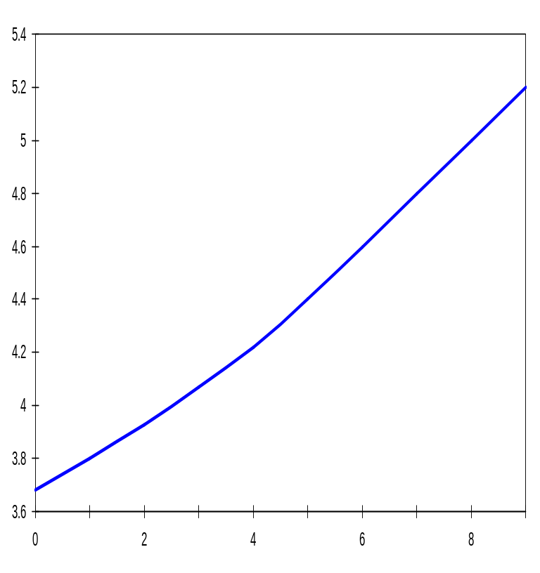
Input Signal Rise/Fall Time
In reality, the input signal changes gradually (and both PMOS and NMOS conduct for a brief time). This affects the current available for charging/discharging C_{L} and impacts propagation delay.
x 10⁻¹¹
t_{p}(sec)
t_{p} increases linearly with increasing input slope, t_{s}, once t_{s} > t_{p}
t_{s} is due to the limited driving capability of the preceding gate
x 10⁻¹¹
t_{s}(sec)
for a minimum-size inverter with a fan-out of a single gate
Notes:
Have assumed until now that the input signal abruptly changes from 0 to Vdd or vice versa. In reality, the input signal changes gradually and, temporarily, the PMOS and NMOS transistors conduct simultaneously).
ts is the input switching time (delay) slope
If the driving gate were infinitely strong, its output slope would be unaffected (by the load).

Slide 21
Design Challenge
A gate is never designed in isolation: its performance is affected by both the fan-out and the driving strength of the gate(s) feeding its inputs.
t^{i}_{p} = t^{i}_{step} + η t^{i-1}_{step} (η ≈ 0.25)
Keep signal rise times smaller than or equal to the gate propagation delays.
  good for performance
  good for power consumption
Keeping rise and fall times of the signals small and of approximately equal values is one of the major challenges in high-performance designs - slope engineering.
Notes:
tstep is for the zero input slope

Slide 22
Delay with Long Interconnects
When gates are farther apart, wire capacitance and resistance can no longer be ignored.
t_{p} = 0.69R_{dr}C_{int} + (0.69R_{dr}+0.38R_{w})C_{w} + 0.69(R_{dr}+R_{w})C_{fan}
where R_{dr} = (R_{eqn} + R_{eqp})/2
= 0.69R_{dr}(C_{int}+C_{fan}) + 0.69(R_{dr}c_{w}+r_{w}C_{fan})L + 0.38r_{w}c_{w}L²
(r_{w}, c_{w}, L)
V_{in}
V_{out}
c_{int}
c_{fan}
Wire delay rapidly becomes the dominate factor (due to the quadratic term) in the delay budget for longer wires.
Notes:
Have been ignoring wire capacitance and resistance so far. Can use the Elmore delay expression to account for long wire capacitance and resistance.
At L = 65 micron, the delay of the interconnect becomes equal to the intrinsic delay caused purely by the device parasitics. The extra delay is solely due to the linear factor in the equation, and more specifically due to the extra capacitance introduced by the wire.
The quadratic factor only becomes dominant at much larger wire lengths (> 7 cm) due to the high resistance of the (minimum-size) driver transistor.

Slide 23
Next Lecture and Reminders
Next lecture
  Designing fast logic
    Reading assignment – Rabaey, et al, 6.2.1
Reminders
  Project specifications due today
  HW3 due next Thursday, Oct 10th (hand in to TA)
  Class cancelled on Oct 10th as make up for evening midterm
  I will be out of town Oct 10th through Oct 15th and Oct 18th through Oct 23rd, so office hours during those periods are cancelled
  We will have a guest lecturer on Oct 22nd
  Evening midterm exam scheduled
    Wednesday, October 16th from 8:15 to 10:15pm in 260 Willard
    Only one midterm conflict filed for so far

